Slide 1
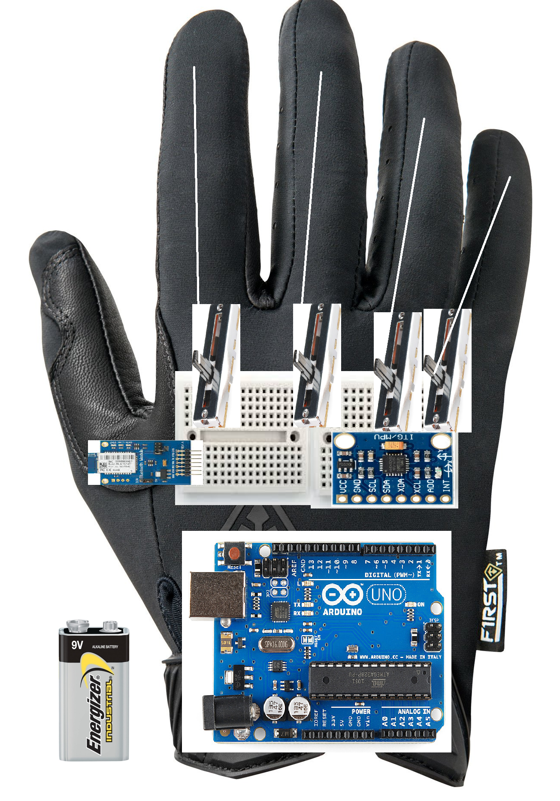
Project Overview/Goals
To create a glove that can enhance the accessibility of video games for disabled users
Have at least 4 inputs. For 2D directional movement, jumping, and an action button
Make the glove usable on PC
Try to minimize board space as much as possible

Slide 2
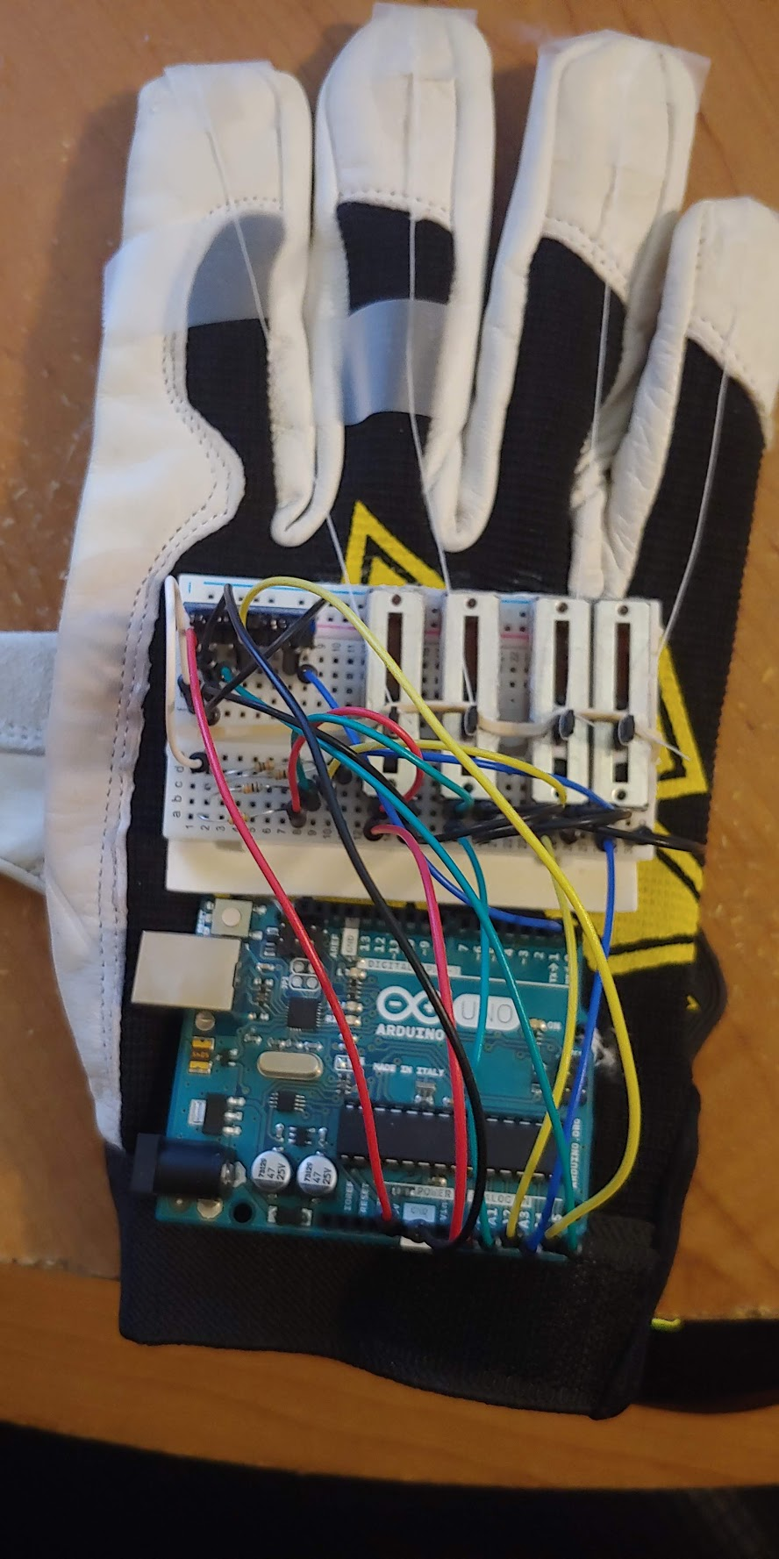
Progress/Demonstration
The Hardware and Software are fully finished
Gyro is mapped left to A, right to D
Slide buttons are: Space, E, R, and T
I will demonstrate using a PC game called Slap City
https://www.youtube.com/watch?v=mzvHvR0xtP4

Slide 3
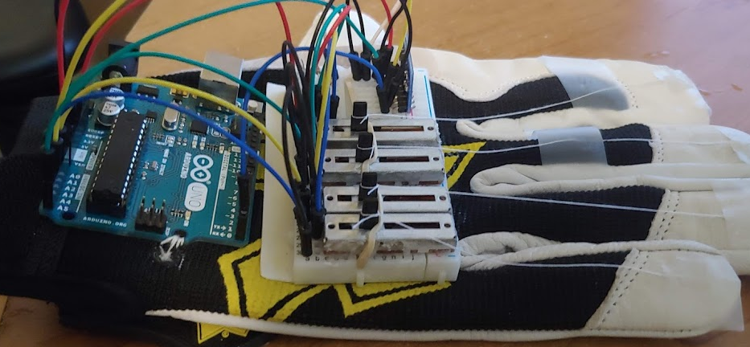
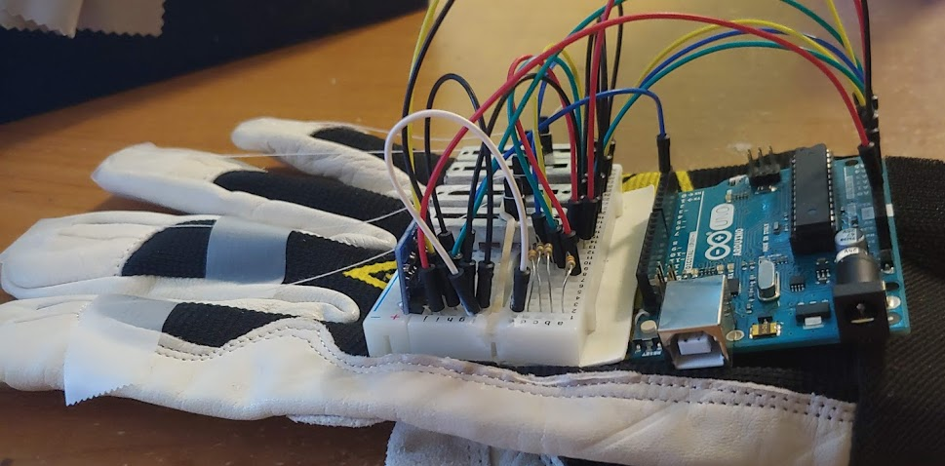

Slide 4
Testing and Optimization
Gyro (0 degrees is flat)
Left: 190-345 degrees
Right: 20-170 degrees
Center: 345-20 degrees
Slide
Min: 12
Max 27
Gyro and slide cutoffs are listed to the right
Pointer finger was glued less tight than others
Min of 9.8
Gyro sensor was accurate well within 5 degrees
Pinky finger was very inconsistent due to how hands work
Improved reliability of processing code with try catch loop
Current consumption of 32mA on average

Slide 5
Successes and Obstacles
The gyro sensor and slide potentiometer were more accurate than I expected
The construction was more durable than expected
Much less lag than expected
Processing software crashing was resolved using try-catch loop and was stable
The pinky finger was hard to optimize
Arduino Micro would be more robust
Arduino Uno was larger than idead
Not enough space for bluetooth module
Notes:
Bluetooth is 6 pin matrix but is too wide on top

Slide 6
Possible Improvements
Use an Arduino Micro
Custom PCB
Interface with Nintendo Switch
Make more visually appealing
Make Wireless
Figure out Pinky workaround

